Slide 1



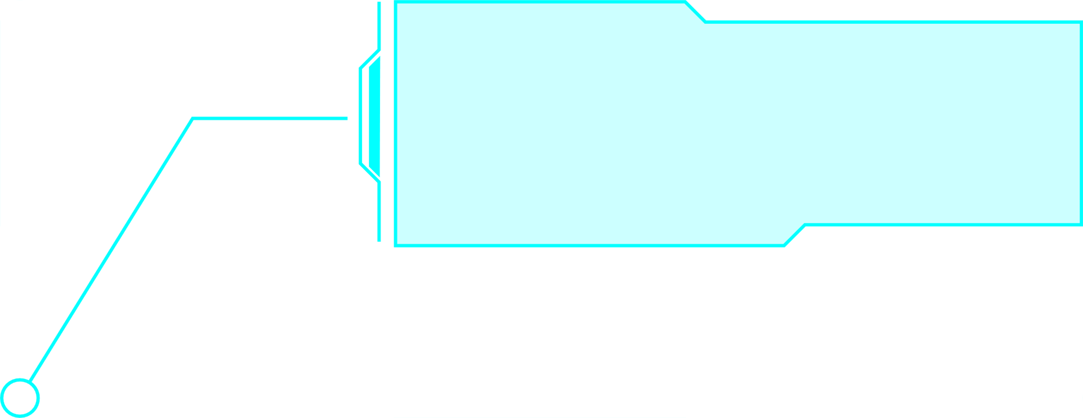
MOHAMED ABUALGASEM
Mini Shopping Cart App with Python
A Python Final Project Presentation

Slide 2
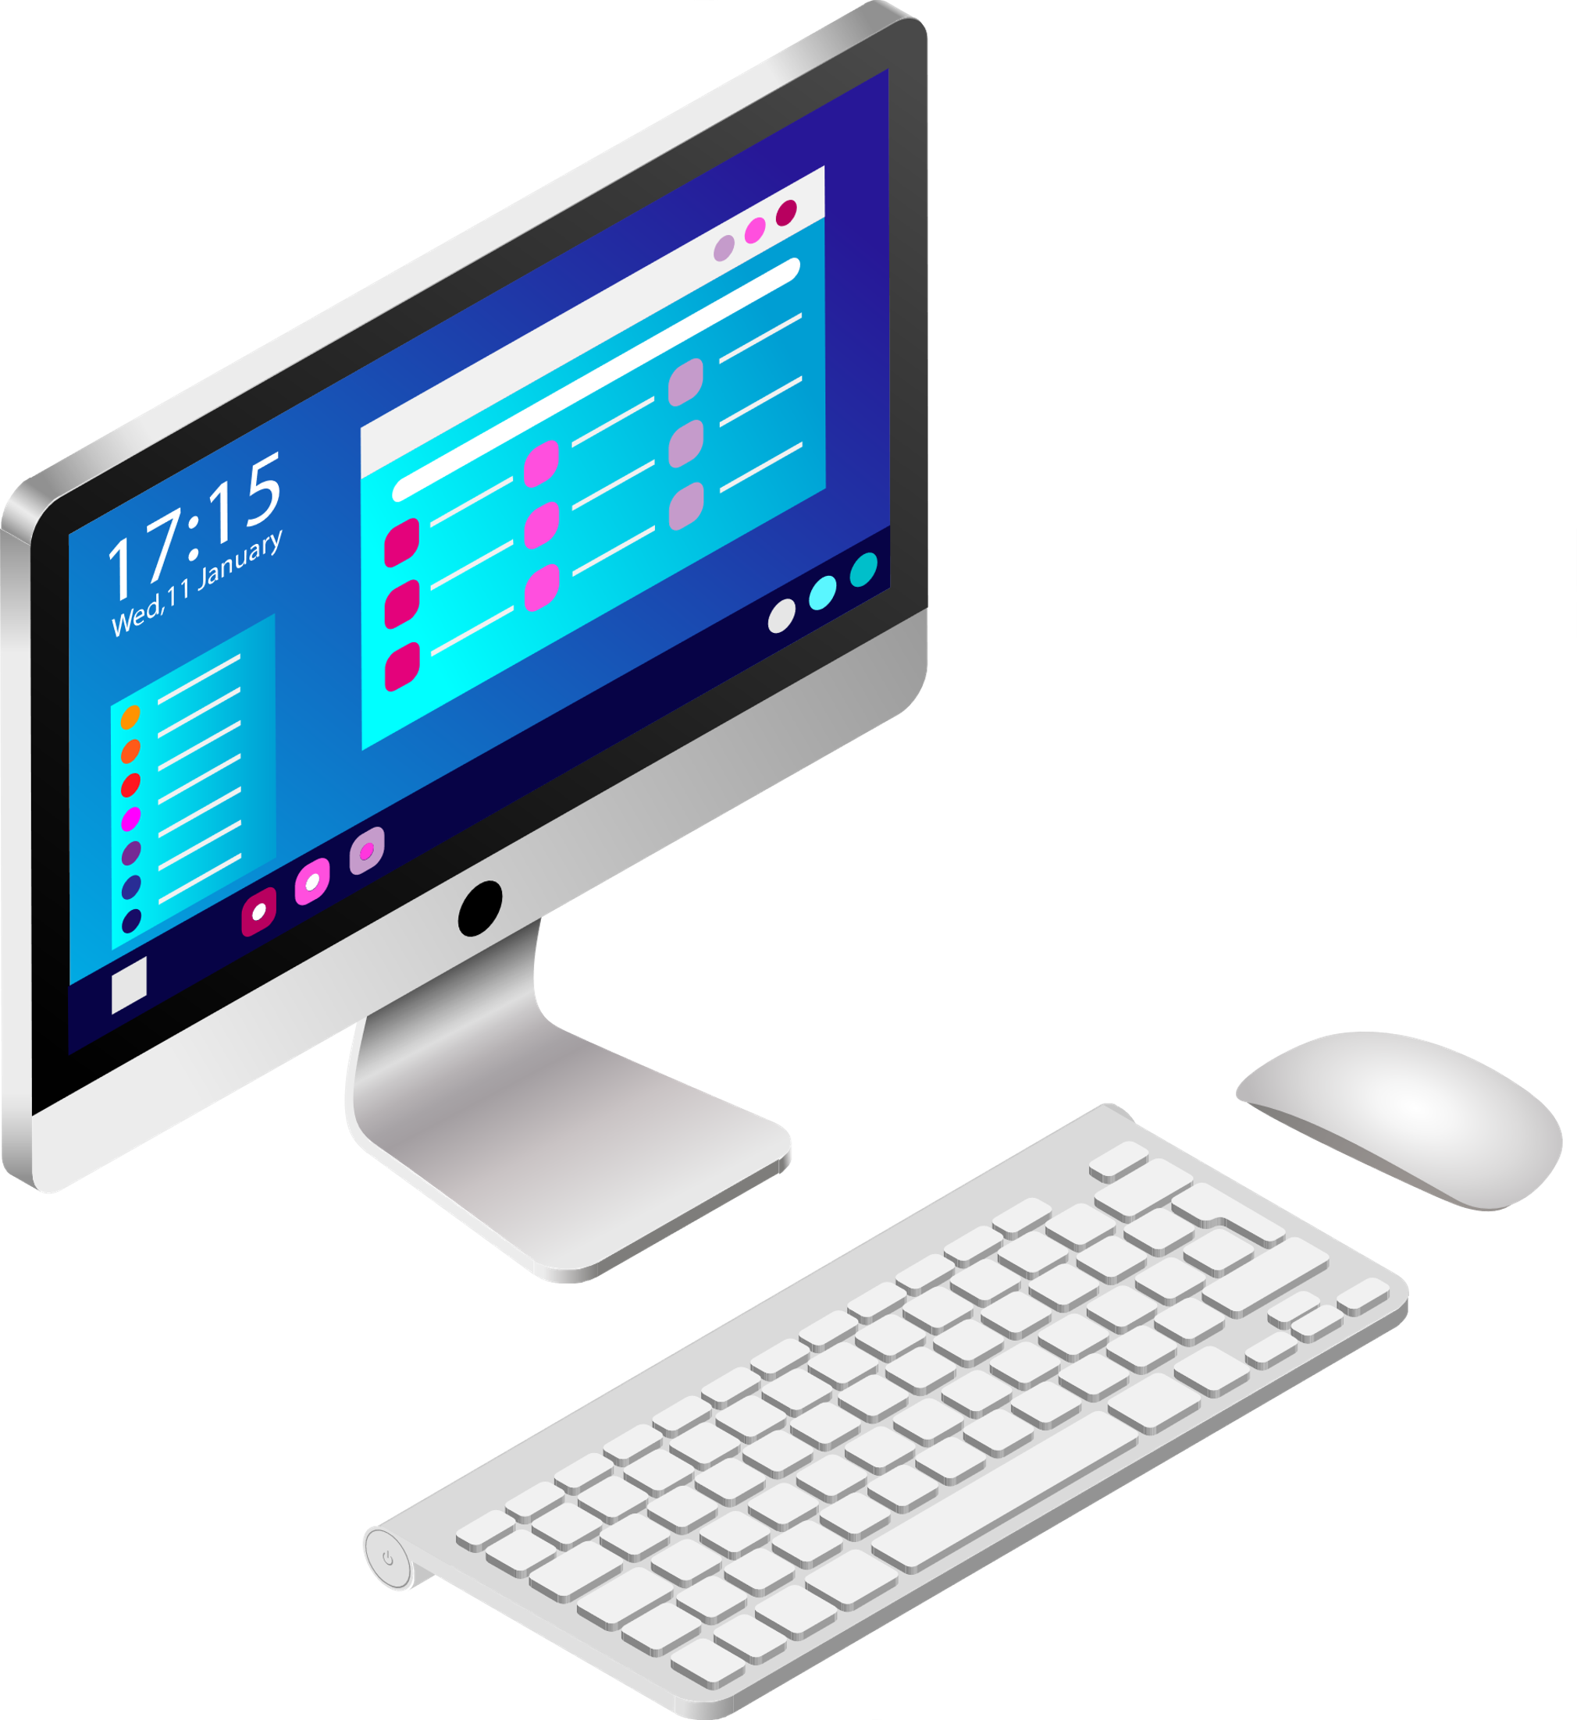
PROJECT OVERVIEW
Goal:
Build a Python-based shopping cart system that allows users to:
Browse products 🛍️
Add/remove items from cart 🛒
View cart and total price 💵
Visualize cart contents 📊
Save cart to a file 💾

Slide 3
TOOLS & TOPICS USED
Python Programming Language
Built-in Concepts:
Arrays (List)
Tuples & Dictionaries
Functions
Module Import
Exception Handling
File Handling
External Library:
matplotlib for data visualization

Slide 4
HOW IT WORKS
Step-by-step Features:
🧾 Show product list with prices
➕ Add product to cart
➖ Remove product
👁️ View cart & calculate total
💾 Save cart to a .txt file
📊 Visualize items in a bar chart

Slide 5
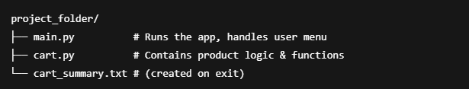
CODE STRUCTURE

Slide 6
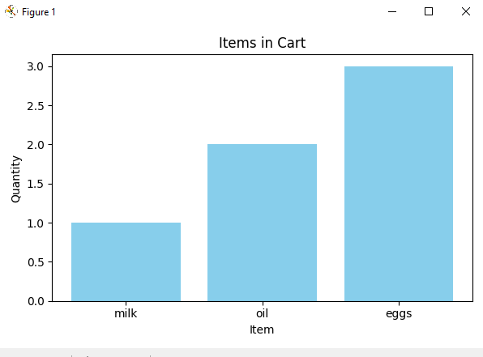
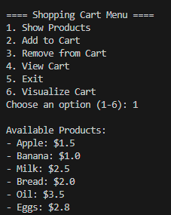
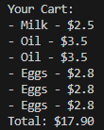
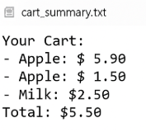
SAMPLE OUTPUT
Bar chart visualization
Product menu
Cart view
cart_summary.txt file

Slide 7
WHAT I LEARNED
How to split code into modules
How to handle user input and exceptions
How to write to files using Python
How to visualize data using charts
How to build a complete Python app

Slide 8
CONCLUSION
This project helped me apply everything I learned:
✅ Basic Python logic
✅ File & error handling
✅ Data display & plotting
Thank you! 🙏

